Slide 1


Analysis of time series data: Part 2
Dan Weinberger, PhD
Epidemiology of Microbial Diseases
Yale School of Public Health

Slide 2
Types of time series analyses
Forecasting and descriptive modeling (last week)
ARIMA models (autoregressive moving average)
Often best for prediction/forecasting
Segmented regression methods
Program evaluation (Surveillance class)
Signal decomposition (today)
Identify timing and amplitude of epidemics
Identify changes in disease dynamics
Denoising
Parameters for curve fitting and transmission models

Slide 4
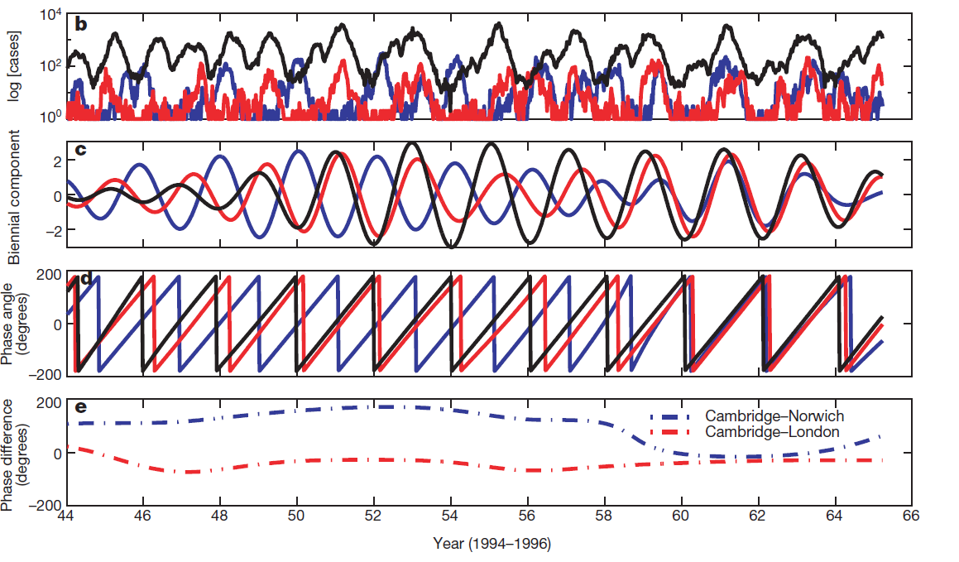
Motivating Question #1: Do the spatiotemporal dynamics of measles change after vaccination?
Grenfell, Science

Slide 5
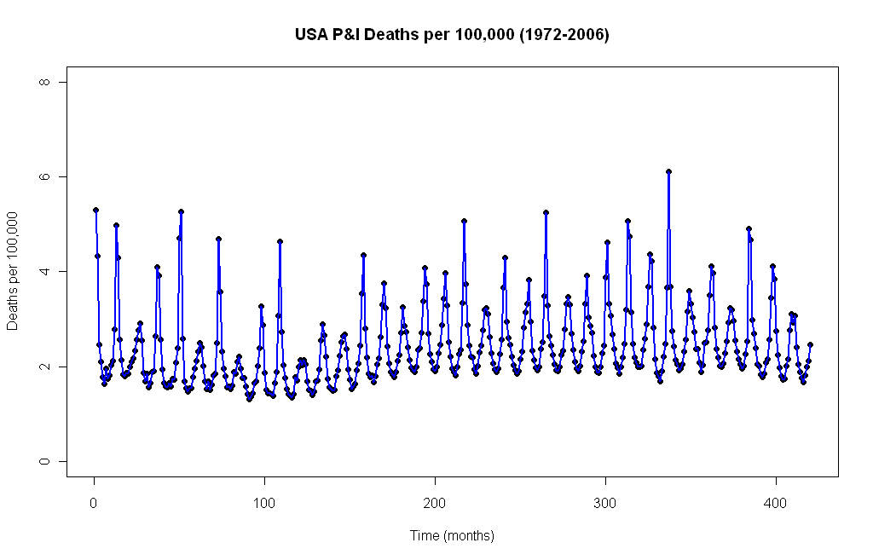
Motivating Question #2: What fraction of pneumonia cases are caused by influenza?

Slide 6
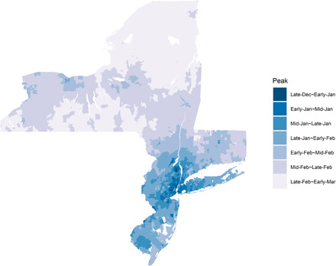
Motivating question #3
How does RSV epidemic timing vary over space?
Zheng, Science Advances 2021

Slide 7
For both of these examples, we need to decompose the signal into different pieces for analysis

Slide 8
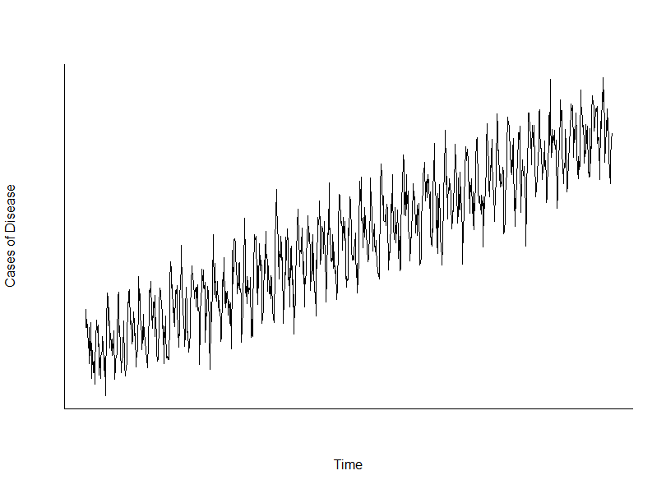
Signal decomposition

Slide 9
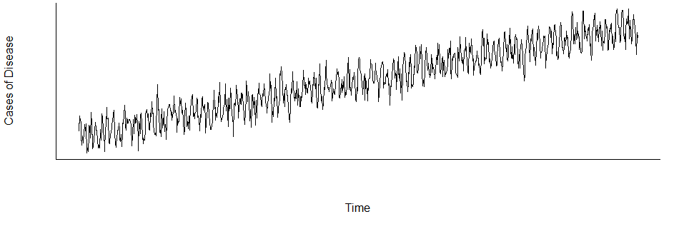
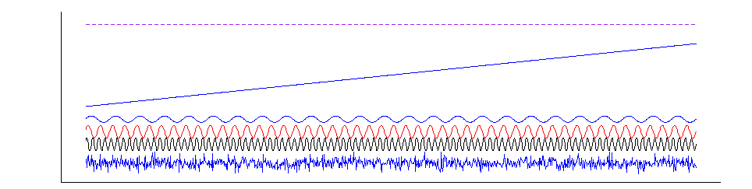
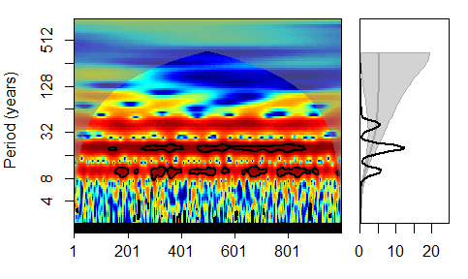
Signal decomposition
Intercept
Trend
Harmonics
Noise

Slide 10
Describing a periodic signal
Period
1/period=frequency
Amplitude
Phase shift
Time

Slide 11
Harmonics
Period (1/ω)
Φ
1/period=frequency= ω
Amplitude (A)
x_{t} = A cos(2πωt + φ) + εt
A=amplitude
ω=frequency
Φ=phase
Εt=error

Slide 12
Periodicity
t
t1
t2
t

Slide 13
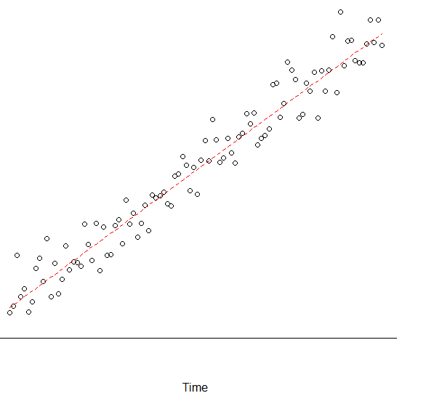
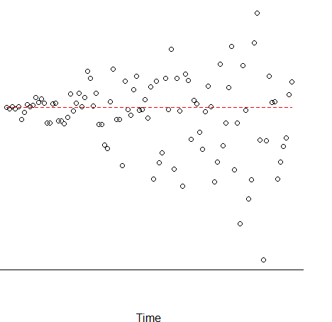
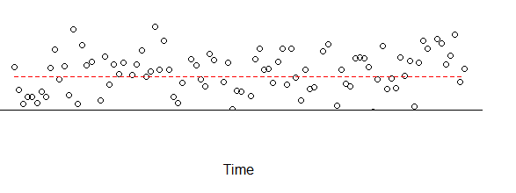
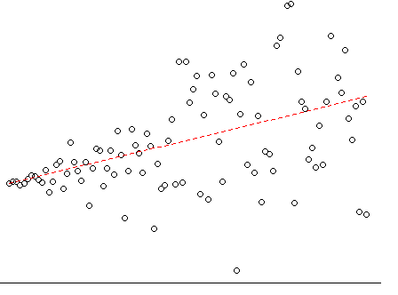
Stationarity of time series
Mean and variance do not change or follow trends
Not stationary
Stationary
Increasing mean,
Constant variance
Constant mean,
Increasing variance
Increasing mean,
Increasing variance

Slide 14
Generating harmonics in R

Slide 15
Decomposing a signal with a linear model
Intercept (β₀)
Trend (β₁)
Harmonics (β₂₋₅)
Noise

Slide 16
Harmonic regression when you know the frequency
xt = A cos(2πωt + φ) + εt
xt = β1*sin(2πωt) + β2*cos(2πωt) + εt
Use linear regression to estimate β1 and β2
RA Stine

Slide 17
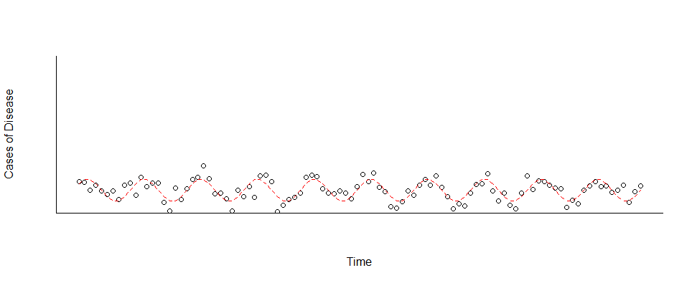
Extracting useful information from harmonic regression
xt = β1*sin(2πωt) + β2*cos(2πωt) + εt
Amplitude =sqrt(β1² + β2²)
Phase angle = -arctan (β1/β2) (-pi to pi)
Example: Weekly time series repeating seasonally:
xt = β1*cos(2πt/52.25) + β2*sin(2πt/52.25) + εt
Notes:
Note to Ginny: I fixed the phase angle equation 11/2017

Slide 18
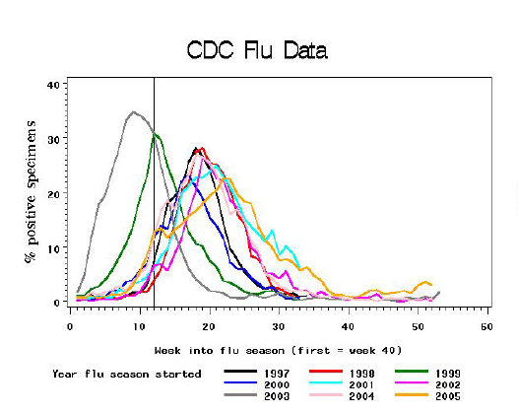
Harmonic regression: Estimation of peak timing (mixed model)
-Compare time series from single location, multiple years
Fit 12 month harmonics to the data to get average (fixed) effects,
and season-specific (random effect) timing estimates for each season
Dickey 2010

Slide 19
What type of model to use
Most commonly we are modeling counts or rates
Use Poisson or negative binomial regression
log(lambda_{t})= b0 + b1*sin(2*pi*t/period) + b2*cos(2*pi*t/period)
Counts_{t}~Poisson(lambda_{t})
Notes:
Note to Ginny: I fixed the phase angle equation 11/2017

Slide 20
Harmonic regression example in R

Slide 21
Example :Estimation of influenza hospitalization burden
Estimate percent of pneumonia cases attributable to influenza, RSV
Need to control for shared seasonality of influenza and pneumonia time series using harmonics
Decompose into trend, seasonality, viral activity
Outcome variable = weekly pneumonia and influenza hospitalization rate
Explanatory variables=influenza-specific and RSV-specific hospitalizations (proxies of viral activity); harmonics, trends
Poisson (or negative binomial) regression for count data
Notes:
21

Slide 22
Example: Estimation of influenza hospitalization burden in California in seniors over 65 yrs
Notes:
22

Slide 23
Fitted Value
Fitted value when flu and RSV set to 0
Flu burden= Y1(t)- Y0(t)

Slide 24
What if we don’t know what periodicity is present in the data?
Fourier analysis
Requires that signal is stationary
Wavelet analysis
Allows for changes in signal over time

Slide 25
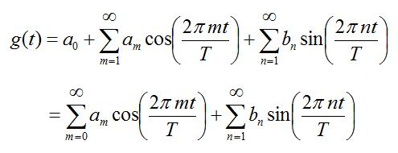
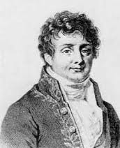
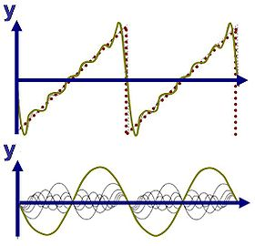
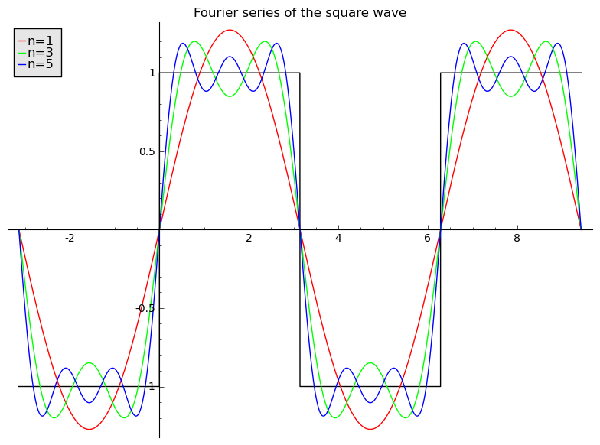
Fourier series
Any signal can be described with a series of waves
Fourier series:
Number in series
Longest period
theFouriertransform.com
Calvin.enlov.net, wiki

Slide 26
Fourier transform
N
Power
time
Frequency
-Converts from “time domain to frequency domain”.
-Is reversible—can reconstruct time series based on Fourier power spectrum!
-Compresses information—summarize time series with just a few pieces of info
N
time

Slide 27
Using the Fourier transform to denoise data
N
Power
time
Frequency
N
time

Slide 28
Computing Fourier transform
Fast Fourier transform (FFT) is most efficient
Many available algorithms
Used with discrete time series
Fourier power spectrum related to Wavelet Power Spectrum (coming up)

Slide 29
A quick demo in R of Fourier analysis

Slide 30
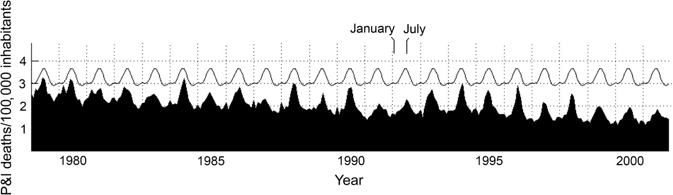
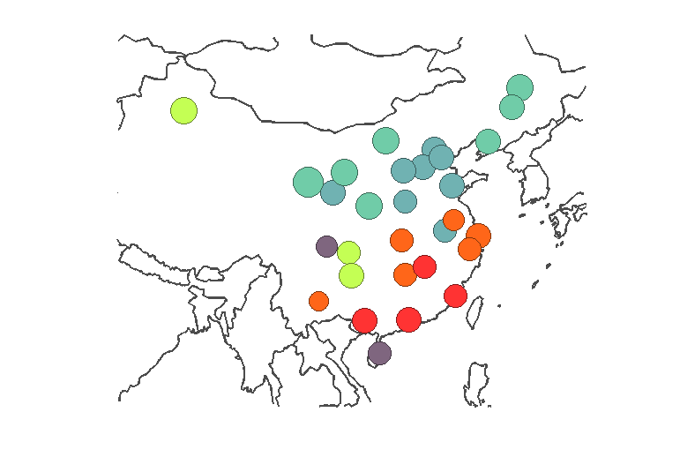
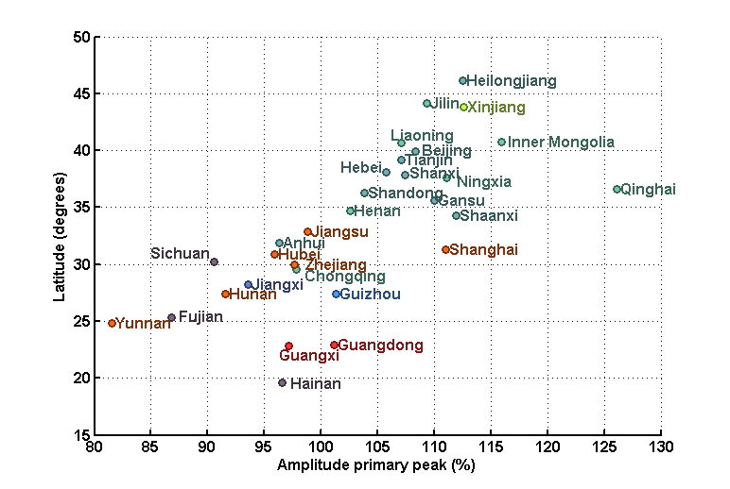
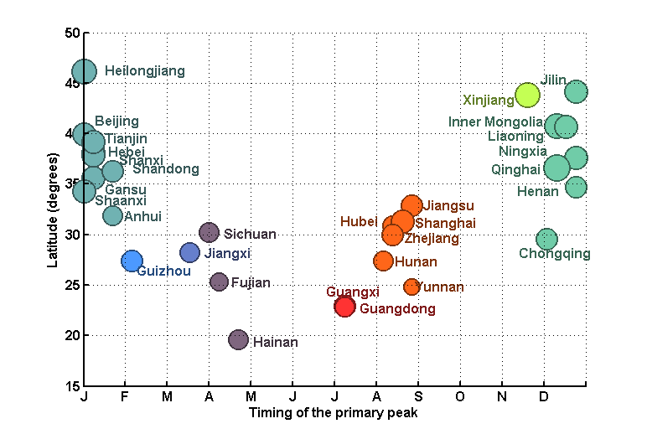
Fourier analysis: Estimation of peak timing
Alonso et al AJE
Viboud PLoS Med
EPIPOI.info
-Compare time series from multiple locations

Slide 31
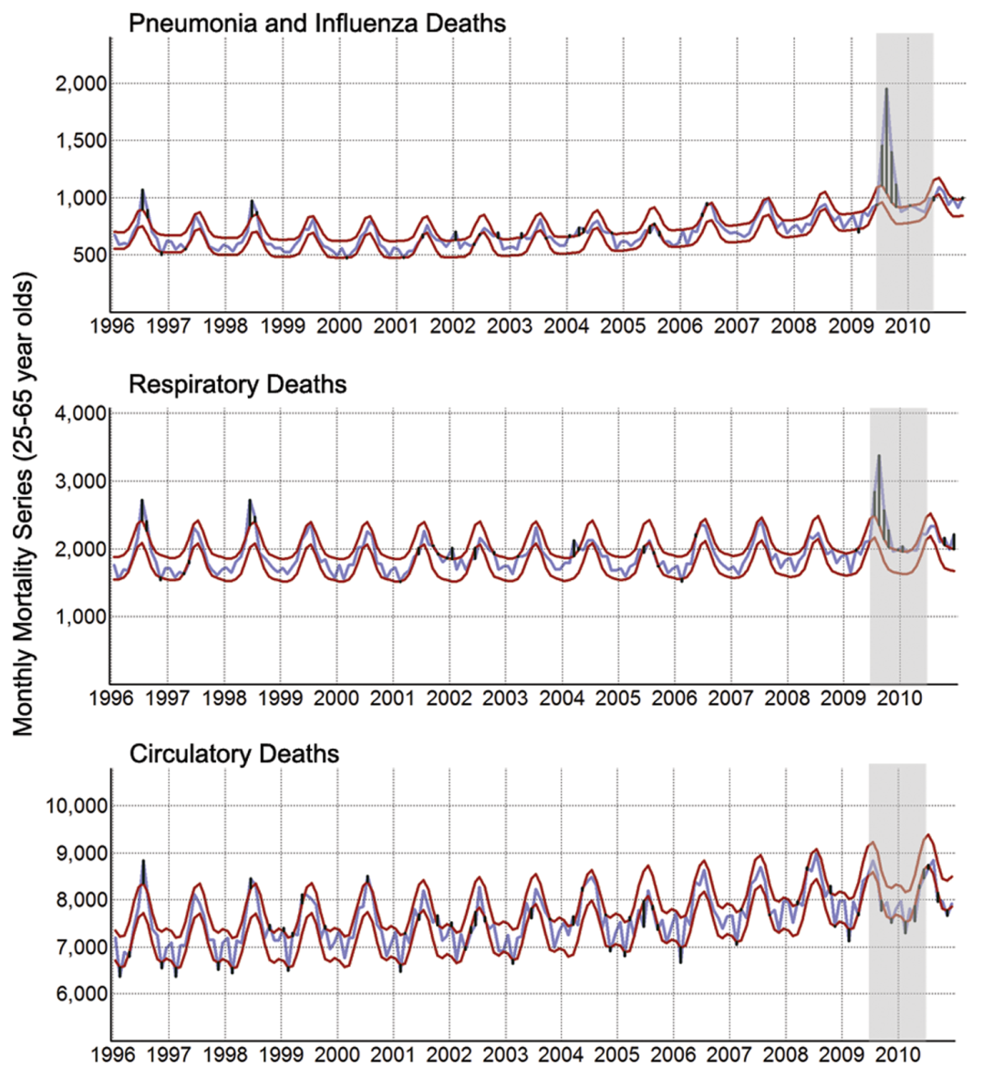
Fourier analysis: Setting an epidemic threshold
-Use partial Fourier series (12,6,3 month harmonics) to estimate baseline and 95% CI
Alonso et al PLoS One

Slide 32
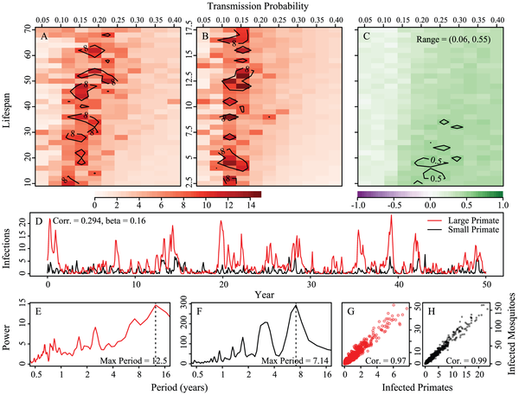
Fourier analysis: Parameterize and analyze dynamic models
E.g. add seasonal forcing
Analyze output from compartmental model
Dengue; Althouse, 2012
PLoS NTD

Slide 33
The limitations of Fourier analysis
Assumes that the harmonic is constant over time (seasonality, multi-year terms)
If there is a change in frequency or you want to detect a change in frequency, you need something more powerful…

Slide 34
Wavelets: a powerful solution
Identification of the dominant frequencies in a series (ie annual, monthly…) at each specific time
Can be used to determine the phase of these cycles
Like Fourier can be used as a filter to remove high or low frequency variations
And many other applications…

Slide 35
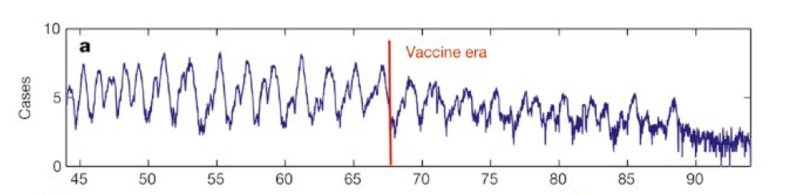
Motivating example: Measles
Does the frequency of the measles epidemics
change after vaccination?
Does the synchronicity change?
Figures from Grenfell et al, Nature 2001

Slide 36
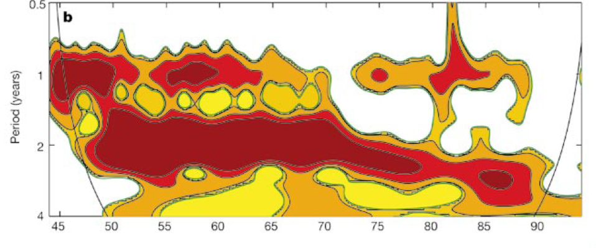
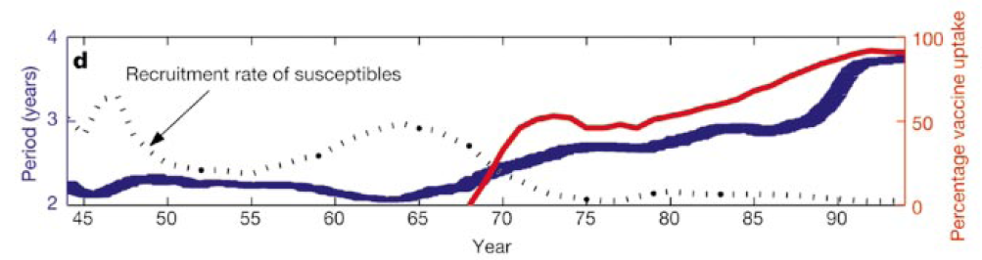
Shift in dominant frequency

Slide 37
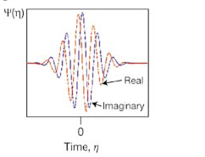
Basic concepts
Sample time series
(wave with 10 unit cycle
=sin(2*π/10*t)
-Wavelets:little waves of a
specific shape
-”slide” wavelet along time
series to determine strength of
correlation
-repeat, while shrinking and
expanding the wavelet
-Can use different shapes of
wavelets for different situations
Higher frequency

Slide 38
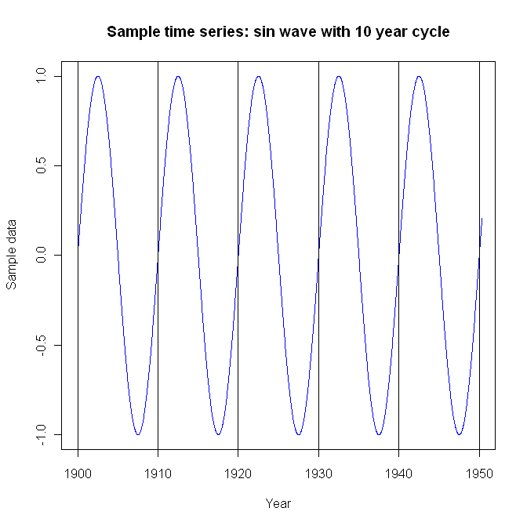
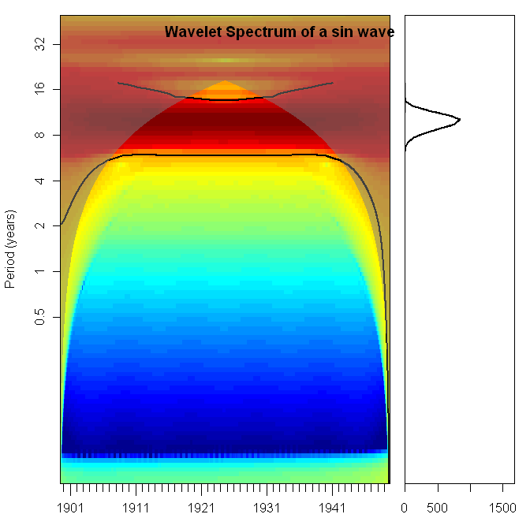
Wavelet spectrum of a sine wave
10 year cycle dominates

Slide 39
Wavelet spectrum of a sine wave
Grey area=
Cone of influence:
Less confidence
in this region
“Global wavelet”=
Average across entire
time period
Color=power of spectra:
Red=higher amplitude at that
frequency and time
Significance tested by a
permutation test

Slide 40
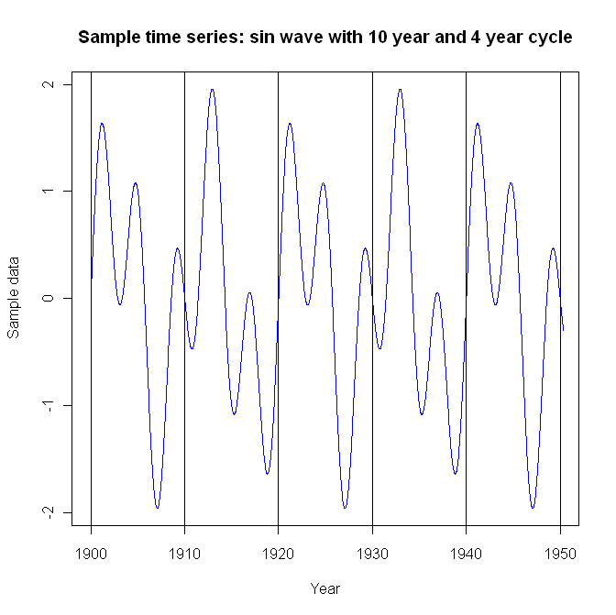
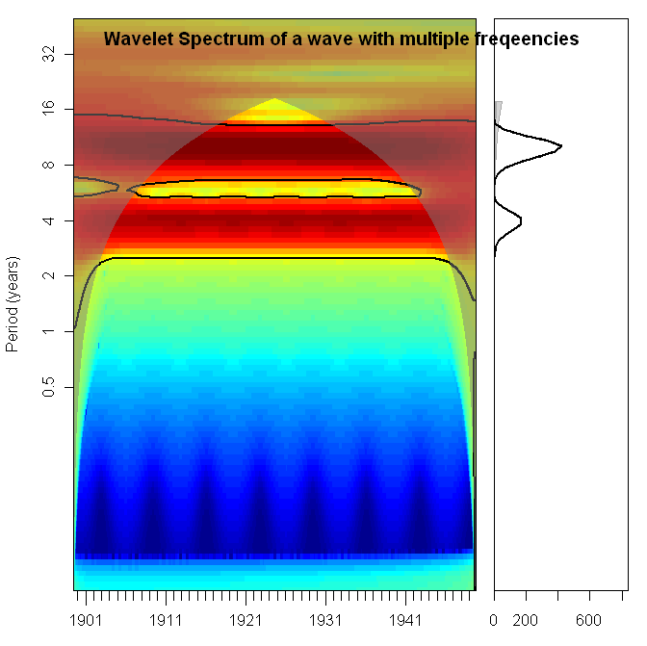
Multiple frequencies

Slide 41
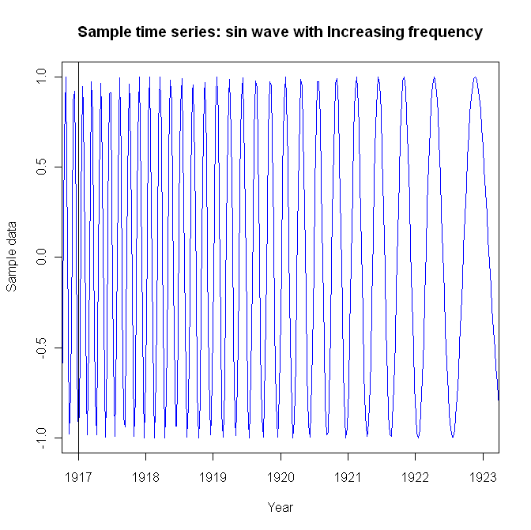
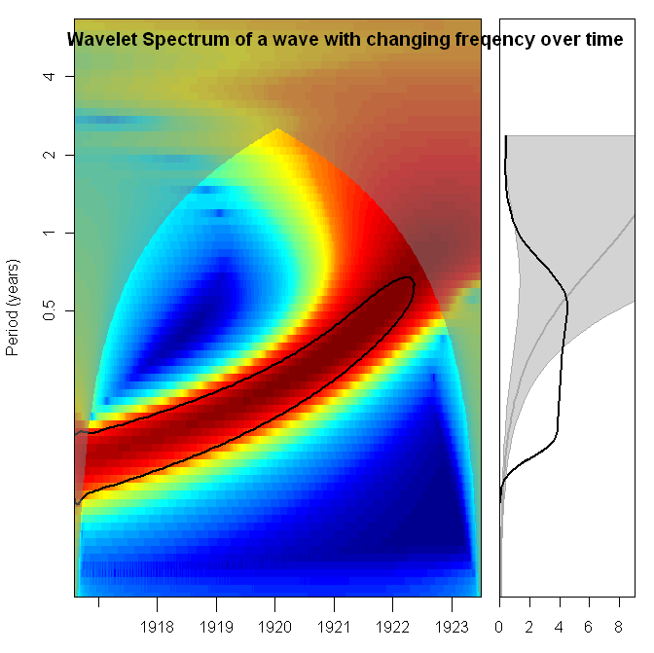
Wavelet with changing frequencies
Interpretation: Wavelength increases from ~0.25 to ~0.5
(from 4 cycles/year to 2 cycles/year)

Slide 42
Example: epidemic timing
Grenfell, Science

Slide 43
Example: Using wavelets to extract phase (timing) information
1.5-3 year
component

Slide 44
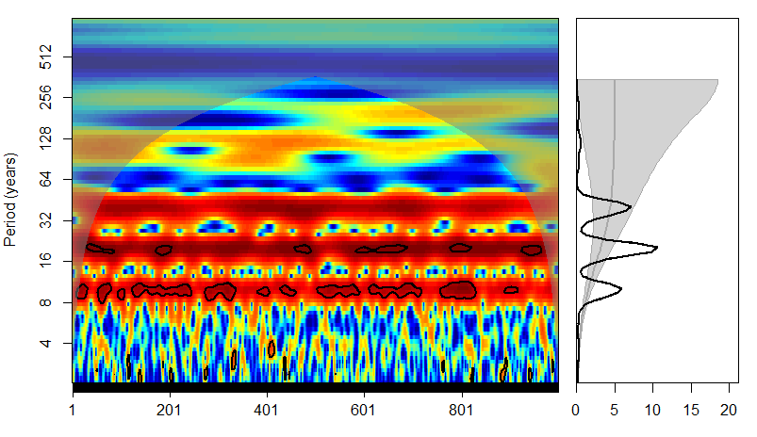
Now what do you see?
Intercept
Trend
Harmonics
Noise

Slide 45
Worked Example: RSV data
RSV data from WHO surveillance database (FluMart)
Identify periodicity in the data
Harmonic regression
Wavelets
Extract information on timing of epidemics

Slide 46
What have we learned?
How to identify the dominant frequencies in a time series
How to extract information about timing and amplitude of epidemics
How to detect changes in epidemic frequency
How to incorporate this into regression models

